Slide 1
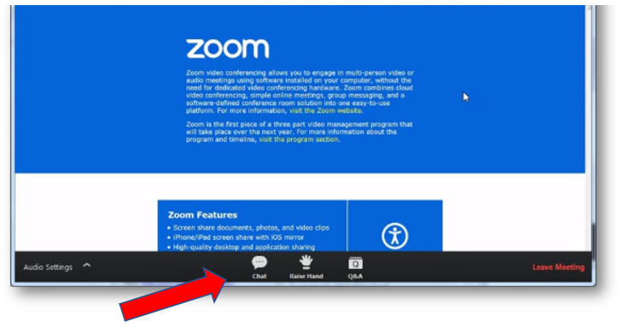
Welcome to the 2020 ADRIA Annual General Meeting
Please feel free to submit comments or questions via the ‘Chat’ or ‘Q&A’ functions
in the menu bar. If you
wish to make or second
a motion, you can
‘Raise Hand’.
Motions requiring a vote will be spoken and then appear on the screen. Submit your vote by clicking on your preferred choice (in favour, against, or abstain).
Only active Full members are eligible to vote at the AGM. Please do not vote if you are not a Full member.

Slide 2
June 11th, 2020

Slide 3
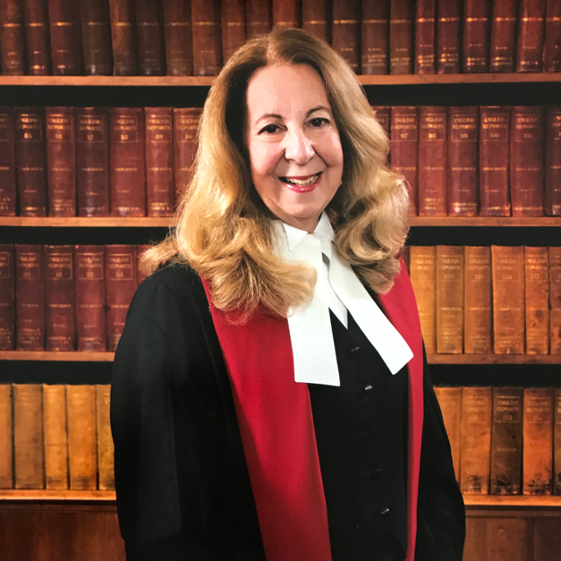
Opening Keynote Address
The Honourable Mary Moreau
Chief Justice, Alberta Court of Queen`s Bench

Slide 4
June 11th, 2020

Slide 5
Online Instructions
You will find the AGM agenda and reports on our Members page. Log in to adralberta.com and select the Members tab. If you are not a Member, you can find the materials by selecting the Annual General Meeting tab.
You may ask questions via the ‘Chat’ or ‘Q&A’ functions during the meeting. You can submit any questions ahead of time to membership@adralberta.com. Questions and comments will be answered in turn.
If you wish to make or second a motion, you can use the ‘Raise Hand’ functions.

Slide 6
Voting Instructions
Online voting will be conducted during the meeting.
The questions being voted on will appear on the screen and you will be able to select your response. Note that only FULL, ACTIVE ADRIA members have voting rights.
Please do not vote if you are not a Full Member.
How to Vote online
When a vote on a motion is required, the question being voted on will announced by voice, and it will be presented on the screen. You will then have approximately thirty seconds to submit your vote by selecting your preferred choice on the screen (In favour, Against, Abstain).

Slide 7
2020 Annual General Meeting
Barbara McNeil
C.Med, Q.Arb
ADRIA President

Slide 8
Call to Order

Slide 9
AGM Agenda
Welcome and Instructions (6:00 pm)
Opening Keynote Address (6:05 pm)
Annual General Meeting (6:30 pm):
Call to Order
Approval of Agenda & Minutes (posted online)
ADR Canada Greetings (ADRIC Representative))
Reports (see online resources)
President’s Report
Treasurer’s Report
Audit Report 2019
Appointment of Auditor for 2020
Education Report
Executive Director’s Report
Presentation of 2020/21 Board of Directors
New Business
Acknowledgements & Recognition
Adjournment
Membership Open Forum and Informal Q&A with Board & Staff

Slide 10
Approval of Agenda

Slide 11
Approval of Minutes
June 2019

Slide 12
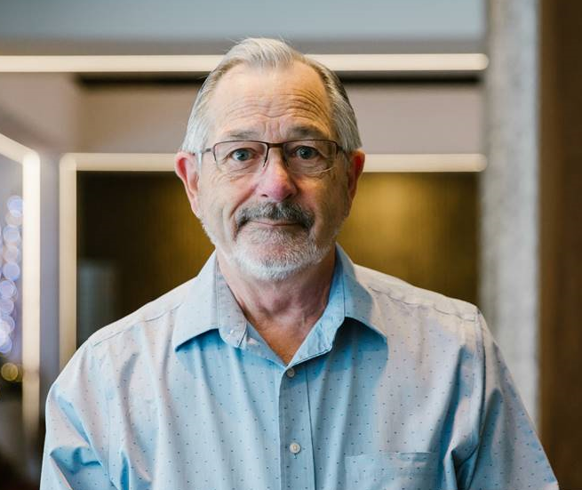
President ADR Canada
Andrew D. Butt
M.S.T., B.Ed., B.Sc.,
C.Med, C.Arb

Slide 13
LEADING DISPUTE RESOLUTION IN CANADA
À L’AVANT-PLAN DE LA RÉSOLUTION DES DIFFÉRENDS AU CANADA

Slide 14
Cross-Country Connectivity Sessions Online Connect with fellow practitioners to learn, share and uplift each other. https://adric.ca/event-calendar/
ADRIC recently sent out a Member Survey
The result is:

Slide 15
More Member Services to help you through unprecedented times
Free recorded webinars on tips for using videoconferencing – look under Events on the ADRIC website
Supporting Members offering Online Video Dispute Resolution Services – We reached out to members via survey to develop a list for counsel or the public.
Practical Resources for Your Practice During the COVID-19 Pandemic – other courses, webinars, documents and links to information in your ADRIC Member Portal

Slide 16
Your ADRIC Member Portal also gives you access to:
ADR in the Media - News and Articles
Work Opportunities & Requests for Proposals across Canada
ODR Task Force Resources
https://mbr.adric.ca/

Slide 17
Construction Adjudication

Slide 18
The ADRIC Conference is now planned to be:
https://adric.ca/conference/adric-2020-webinar-series/

Slide 19
ADRIC Med-Arb Rules
I. MODEL DISPUTE RESOLUTION CLAUSE
Parties who agree to submit disputes under the Med-Arb Rules may use this clause in their agreement:
All disputes arising out of or in connection with this agreement, or in respect of any legal relationship associated with or derived from this agreement, will be finally resolved by Med-Arb under the Med-Arb Rules of the ADR Institute of Canada, Inc. The Seat of Arbitration under the ADRIC Arbitration Rules will be [specify]. The language of the Med-Arb will be [specify].
II. TYPES OF DISPUTES TO WHICH THE MED-ARB RULES APPLY
Although the Med-Arb Rules were drafted to assist in resolving domestic commercial disputes, parties may want to apply them to international or non-commercial disputes.
Parties should examine the Med-Arb Rules to ensure that their provisions are appropriate and conform with applicable legislation.
In Québec, Article 2639 of the Civil Code of Québec, L.R.Q., c. C-1991, provides that disputes over the status and capacity of persons, family matters, or other matters of public order may not be submitted to arbitration.
Finalized, in design and will be available soon in both languages: https://adric.ca/rules-codes/adric-med-arb-rules/

Slide 20
Professional Designations
ADRIC designations allow our members to convey their level of experience and skill to prospective users of their services based on an objective third party assessment.
Highly experienced members can apply for the Chartered Mediator (C.Med), the Chartered Arbitrator (C.Arb) and now, the Chartered Mediator-Arbitrator (C.Med-Arb) designations!
Members with appropriate training and some practice experience can apply for the Qualified Mediator (Q.Med) and the Qualified Arbitrator (Q.Arb) designations, which indicate they have been judged to be practicing at an entry level.
C.Med
C.Arb
C.Med-Arb
Q.Med
Q.Arb
NEW!
Ask ADRIA how to apply!

Slide 21
You can now have your ADR Course Nationally Accredited by ADRIC!
Benefits for Course Providers:
Website Listing
Advertising Aids
Referrals
To apply: education@adric.ca

Slide 22
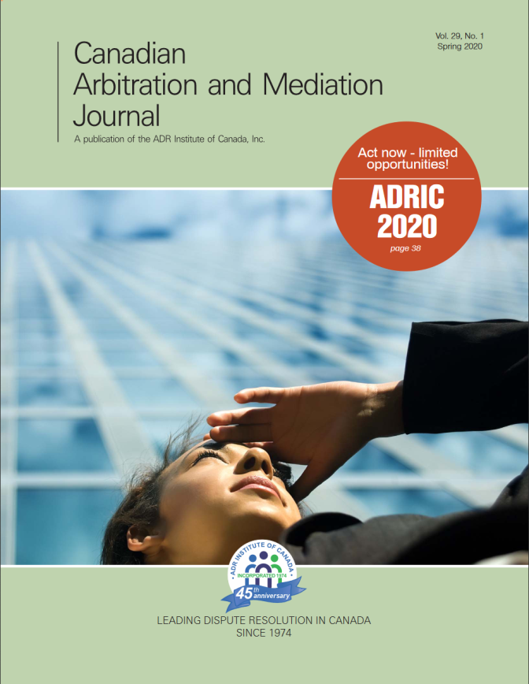
Send us your articles!
ADR Perspectives
Only 900 words! https://adric.ca/useful-links/adr-perspectives-newsletter/
We are also accepting articles for the Canadian Arbitration and Mediation Journal – maximum 2500 words.
https://adric.ca/useful-links/journal-articles/
Get your name out there: ADRIC’s webpages generate about 24,000 views per month!

Slide 23
Sustaining Corporate Members
These organizations have joined ADRIC as leaders in Alternative Dispute Resolution and receive numerous special benefits.

Slide 24
Thank you!
LEADING DISPUTE RESOLUTION IN CANADA
À L’AVANT-PLAN DE LA RÉSOLUTION DES DIFFÉRENDS AU CANADA
Comments or suggestions are always welcome: executivedirector@adric.ca

Slide 25
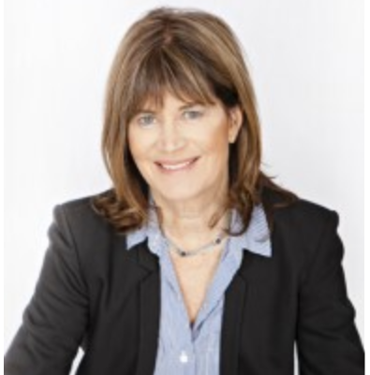
President’s Message
Barbara McNeil, C.Med, Q.Arb
ADRIA President 2019/2020

Slide 26
Strategic Initiatives (pre-Covid)
ADRIA Board of Directors’ Strategic Initiatives for 2019/2020:
Create the strategic business plan to have ADRIA ready to be a self-regulating professional organization, should the need arise.
Focus on and develop the key relationships that advance the interest of ADRIA members.
Develop and administer dispute resolution rosters to access the services of ADRIA’s members.
Define competencies for dispute resolution practitioners.
Develop revenue streams in addition to training.
December 6th, 2019

Slide 27
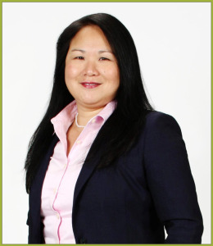
Treasurer’s Report
Dora Dang, C.Med, C.Arb
ADRIA Treasurer

Slide 28
2019 Audit Report

Slide 29
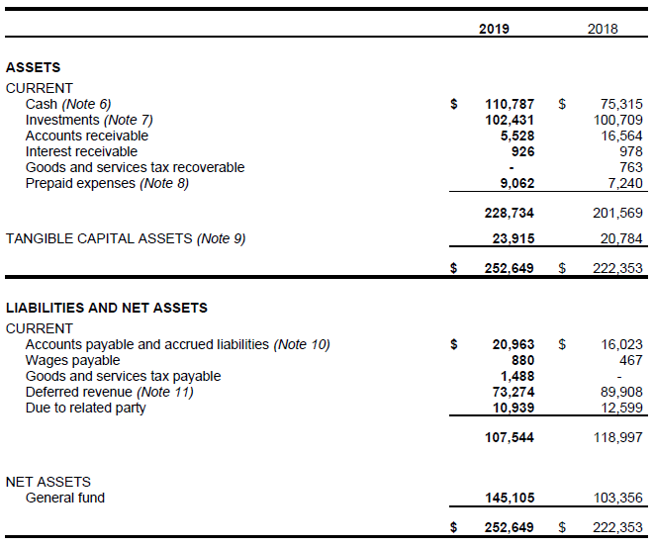
2019 Audit Report (1)

Slide 30
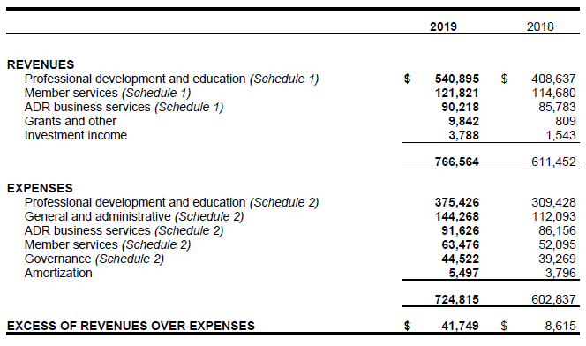
2019 Audit Report (2)

Slide 31
Total Net Assets 2012 - 2020

Slide 32
Treasurer’s Report
Motion to accept 2019 Audit Report
Motion to appoint auditor for 2020

Slide 33
ADRIC Representative’s Report
Barrie Marshall
Alberta`s Representative to ADRIC
Prompt Payment & Adjudication Legislation

Slide 34
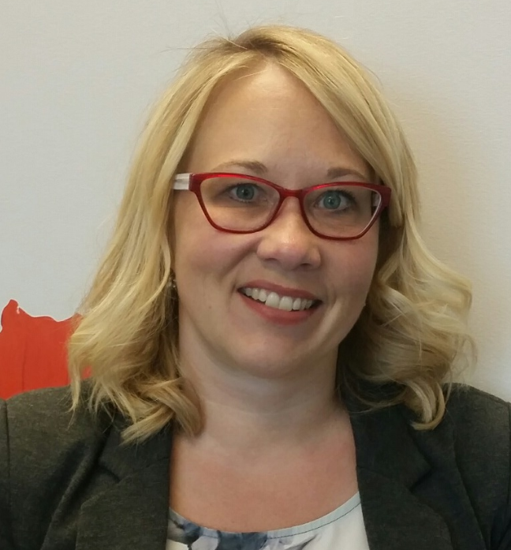
ADRIA Professional Development & Education
Tammy Borowiecki, C.Med, Q.Arb, Director
Sandra Drake, Education Coordinator
Jocelyn Christian, Education Special Projects Coordinator
Naatasha Mohammed (on personal leave)

Slide 35
Executive Director’s Report
Paul Conway

Slide 36
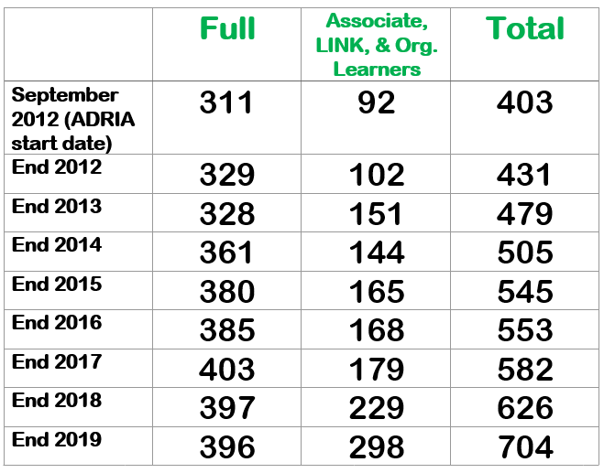
ADRIA Membership

Slide 37
2019 New Designations Awarded
1 Chartered Mediator
2 Chartered Arbitrators
18 Qualified Mediators
11 Qualified Arbitrators
For Designations, Alberta still leads Canada in growth and in percentage of members with designations (70%)

Slide 38
2020 Incentives for Chartered

Slide 39
Instructors, Coaches & Volunteers

Slide 40
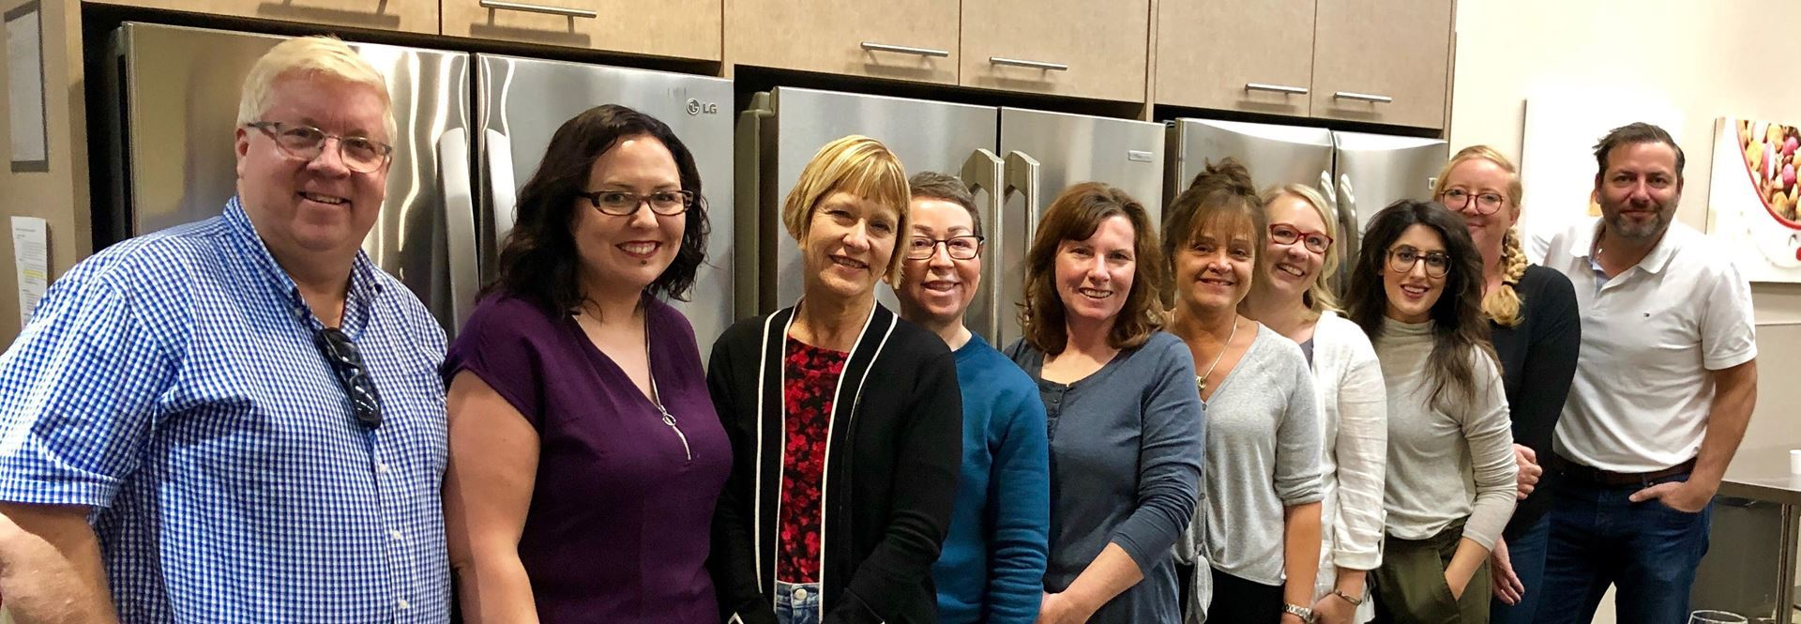
ADRIA Staff 2019

Slide 41
Current ADRIA Staff (Covid-19)
Paul Conway
Tammy Borowiecki
Sandra Drake
Jocelyn Christian
Brenda Davidson
Kristy Rhyason
Karen Sommerfeld
Don Schapira

Slide 42
ADRIA’s Covid-19 Response
Staff & Member Safety
Enhance the Value of ADRIA Membership
Financial Stability
Reduce Expenditures
Access Government Covid-19 Supports
Invest in the future
Online Learning
Re-imagine ADRIA

Slide 43
Board of Directors

Slide 44
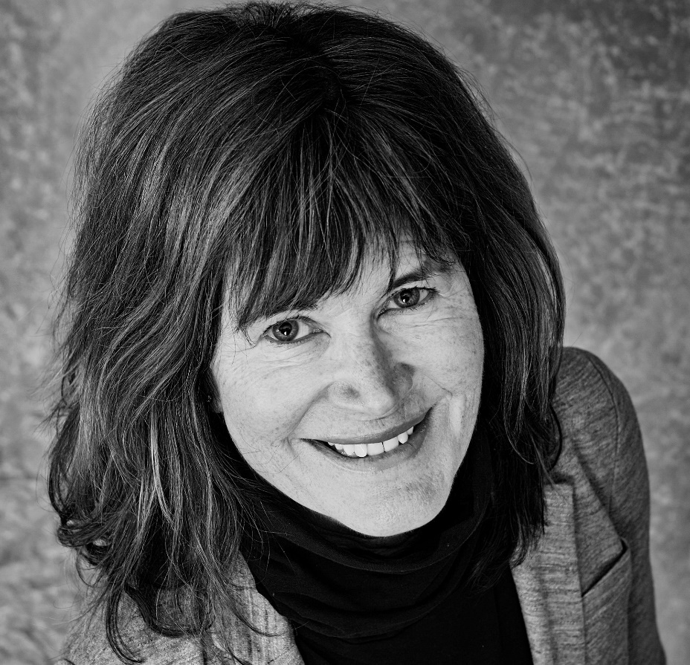
President of the Board
Barbara McNeil
C.Med, Q.Arb
ADRIA President

Slide 45
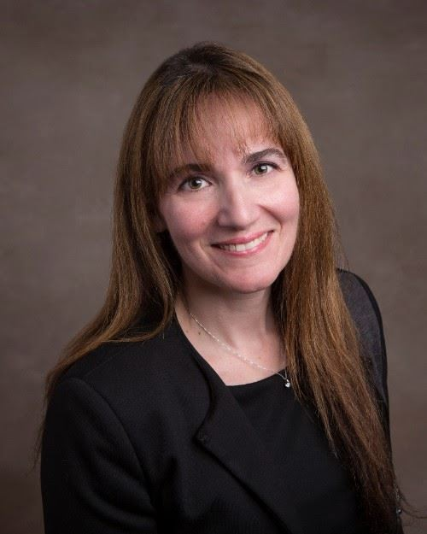
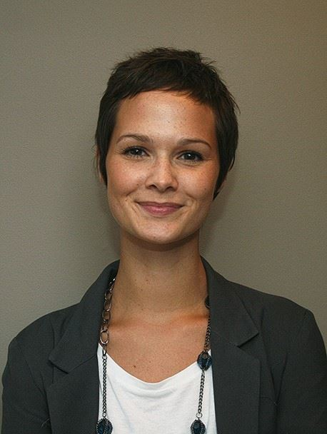
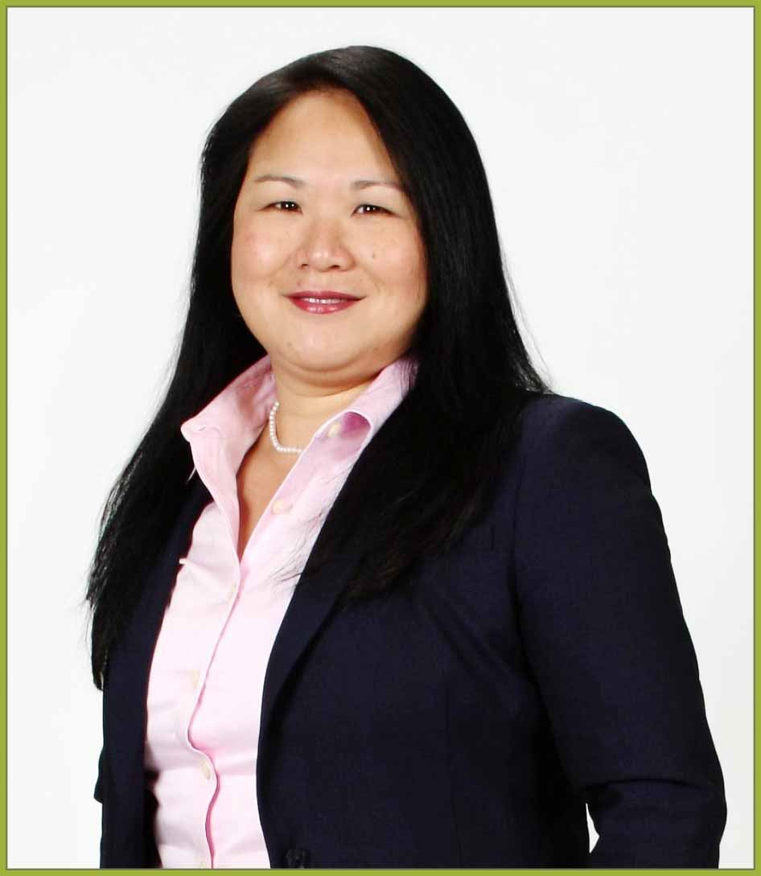
2019 Board Executive
Michelle Bonnici
Vice President
Ali Ansell, Q.Med
Board Secretary
Dora Dang, C.Med, C.Arb
Treasurer

Slide 46
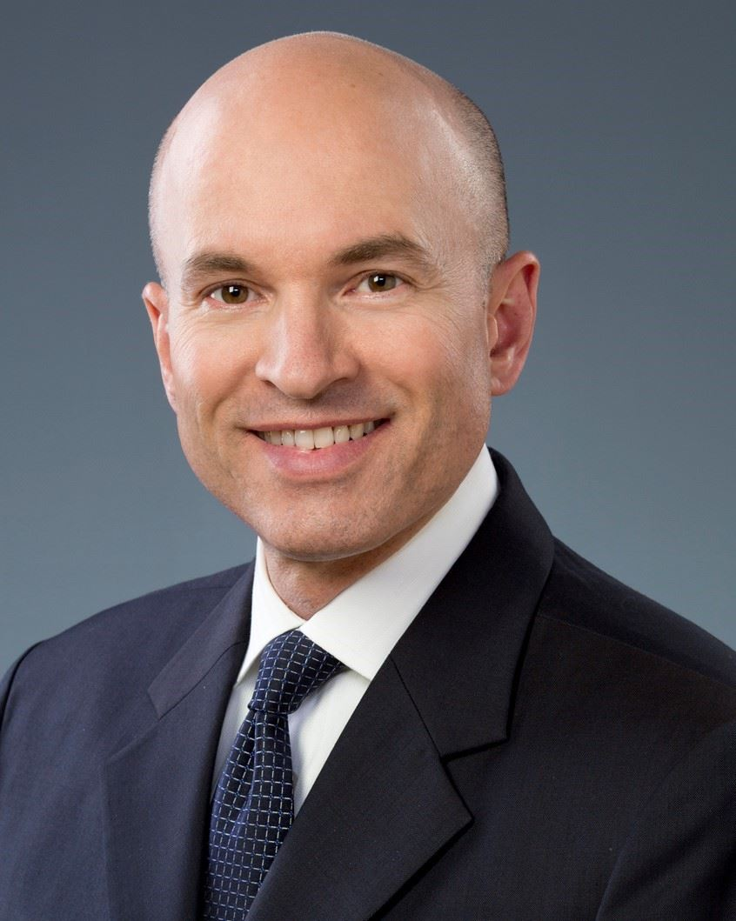
ADRIC Rep & Governance Chair
Kevin Kelly
Q.Med, Q.Arb
Governance Chair
Barrie Marshall
ADRIC Rep

Slide 47
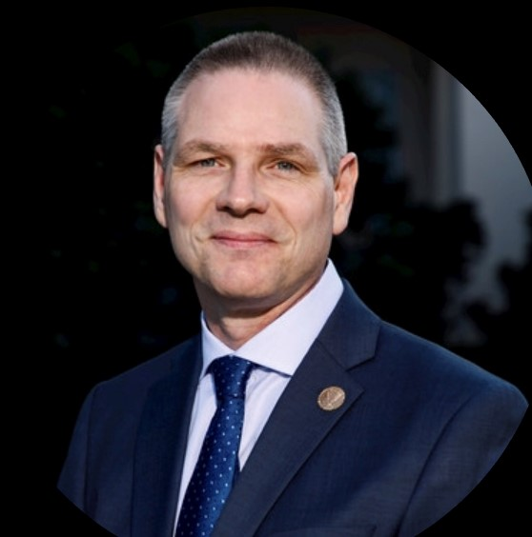
Past President & Directors
Michelle Simpson,
C.Med, C.Arb, Past President
Paul Blakeney,
C.Med, Director
Doug Devlin,
Director
Amin Poonja,
Q.Med, Director

Slide 48
ADRIA 2020/21 Directors
Two Departing Board Members
Two Brand New Directors
Six Returning Board Members

Slide 49
Re-elected – Second Term
Amin Poonja, Q.Med
Dora Dang, C.Med, C.Arb

Slide 50
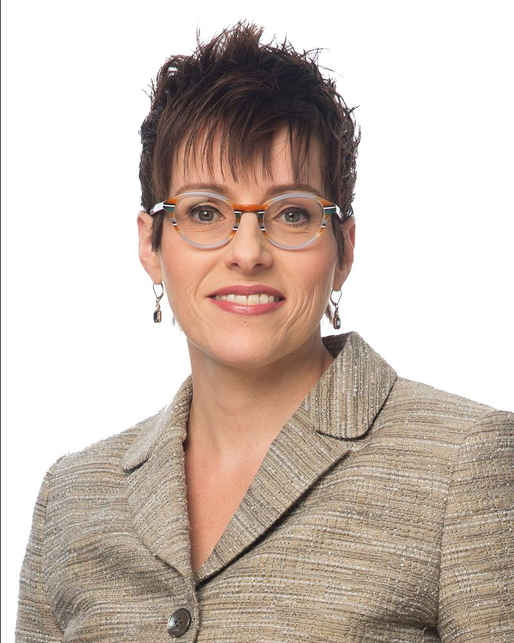
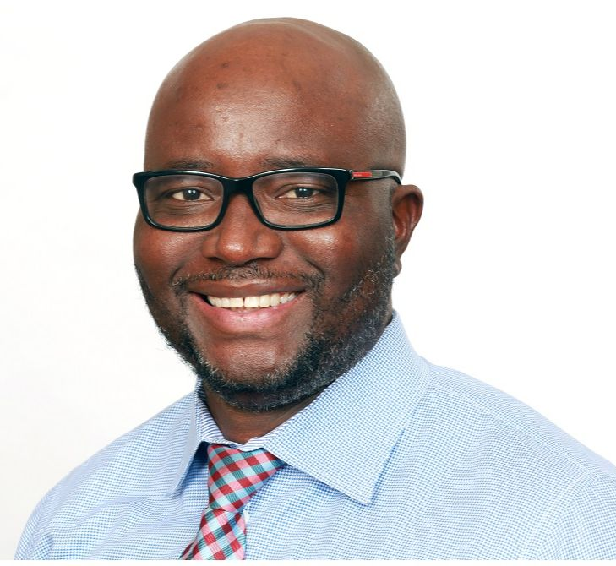
Newly Elected Board Members
Sam Sele, Q.Med Sharon Roberts, Q.Arb

Slide 51
ADRIA 2020/21 Directors
Barbara McNeil President
Michelle Bonnici Vice President
Dora Dang Treasurer
Barrie Marshall ADRIC Representative
Kevin Kelly Governance Chair
Ali Ansell Secretary
Paul Blakeney Director
Amin Poonja Director
Sharon Roberts Director NEW
Sam Sele Director NEW
Vacant/TBA Past President

Slide 52
New Business

Slide 53
Acknowledgements & Recognition
Also, nominations are sought for ADRIC’s Regional & National McGowan Awards.
Deadline end-July 2020

Slide 54
Departing Board Members
Michelle Simpson
C.Med, C.Arb
Past President
Doug Devlin
Director

Slide 55
Adjournment

Slide 56
Membership Open Forum Informal Q&A with Board & Staff

Slide 57
ADRIA 2020 AGM

